Slide 1
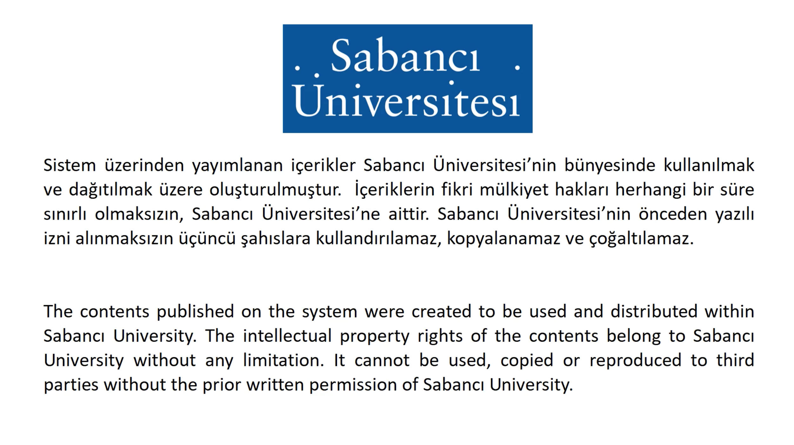

Slide 2
CS 201 Introduction to Computing
Fall 2021-2022
Notes:
deneme

Slide 3
Weeks-11-12
Using, understanding, updating classes
Designing, implementing classes
Textbook Sections 5.4, 6.1, 6.2, 7.1, 7.2

Slide 4
Classes and Objects
A class is defined as a kind of programmer-defined type
Classes are used to combine everything for a concept (like date, student)
Data (state) (e.g. student id, gpa)
Functions (behavior) (e.g. students enroll, graduate)
We define variables of types (like int, double) Similarly, we define objects of classes
an object is a member of a class

Slide 5
Classes and Objects
The behavior of a class is defined by its member functions (methods) by which objects of that class are manipulated
You should know the member functions and what they do
name of the function
parameters and parameter types
return type
functionality
You don't need to know how the function is implemented
analogy: you can add two int variables using +, but you don't need to know how computer really adds
more analogy: you can drive cars, but you don't need to know how the fuel injection works

Slide 6
An Overview of
Object Oriented Programming (OOP)
Why classes and objects? Why object-oriented programming?
Gives programmers the ability to write programs using off-the-shelf components without dealing with their complexity
Saves time and effort
Objects are how real-world entities are represented
In OOP, Data and Functions for a specific concept are combined together
called a "class"
gives the general definition
provides reusability
change the values of data and you end up with different objects with the same functionality
can be used by several applications

Slide 7
An Overview of
Object Oriented Programming (OOP)
An example without OOP - Calendar display program
needs several utility functions
leap year check
day of week function
…
Data
day
month
year
day of week
MonthName
leap year
Function
. . .
Is this structure complex?
for some yes, for some no

Slide 8
An Overview of
Object Oriented Programming (OOP)
OOP version - Calendar display program
Date concept is developed as a class
data and functions combined together from the point of view of programmer
Data (day, month, year)
Functions Day of the week Month name …
Did you like this?
for some yes, for some no
OOP approach is more suitable for a human being
human cognition is mostly based on objects

Slide 9
Using classes
Another way of looking at OOP
Using only string, int and double limits the kinds of programs we can write (games, calendars, …)
Why don't we have off-the-shelf components for programming?
Using OOP techniques means we develop new types that correspond to the real-world objects we're writing code for
for example: an online roulette game, chess, pişti, tavla
some write for us and we use them → off-the-shelf components
New types are called classes, variables are called objects
User defined classes
Tapestry Classes: classes written by Owen Astrachan (book's author) for educational and practical purposes
BigInt and other classes (like Date and Dice) that we will see

Slide 10
The class Date
The class Date is accessible to client programmers
#include "date.h"
To get access to the class
The compiler needs this information
It may also contain documentation for the programmer
Link the implementation in date.cpp
Add this cpp to your project
The class Date models a calendar date:
Month, day, and year make up the state of a Date object
Dates can be printed, compared to each other, day-of-week determined, # days in month determined, many other behaviors
Behaviors are called methods or member functions

Slide 11
Constructing Date objects – usedate.cpp
Date today;
Date republic(10,29,1923);
Date million(1000000);
Date y2k(1,1,2000);
cout << "today: " << today << endl;
cout << "Republic of Turkey has been founded on: "
<< republic << endl;
cout << "millionth day: " << million << endl;
OUTPUT
today: December 14 2020
Republic of Turkey has been founded on: October 29 1923
millionth day: November 28 2738

Slide 12
Where is a Class Defined?
Class definition/interface is in a header file (.h file)
member function prototypes and some other declarations
Implementations of the member functions are in a .cpp file
Date example
class definition/interface is in date.h
that is why it is included in usedate.cpp
class implementation is in date.cpp
part of the project – linked together

Slide 13
date.h (partial)
#ifndef _DATE_H
#define _DATE_H
class Date {
public:
// constructors
Date(); // construct date with default value
Date(long days); // construct date from absolute #
Date(int m,int d,int y); // construct date with specified values
// accessor functions
int Month() const; // return month corresponding to date
int Day() const; // return day corresponding to date
int Year() const; // return year corresponding to date
int DaysIn() const; // return # of days in month
...
private:
int myDay; // day of week, 0-6
int myMonth; // month, 0-11
int myYear; // year in four digits, e.g., 1899
...
};

Slide 14
Parts of Class Definition
Public
Member functions as seen by programmer
Programmer can use functions defined in public section only
Constructors
special member function to create objects (variables)
there might be several constructors with the same name, but different parameters (not necessarily, i.e. Dice class)
Private
Mostly the data part of the class
Necessary for internal implementation of class
e.g. myDay – used by Day(), Absolute()
Not accessible by programmer
e.g. in usedate.cpp, programmer cannot modify myDay

Slide 15
How to
How to define objects? class_name object_name_1, object_name_2, …, object_name_n;
Do not forget the arguments for each object, if any
How to call a member function? object_name.function_name(arguments);
a member function operates on an object for which it is called
Notes:
Debugging into the class would be nice here!

Slide 16
Some more recommendations
IMPORTANT RULE: An object or a variable can be referred only in the compound block in which it is declared
A compound block is the statements and declarations within matching curly brackets { }
e.g. after if or else, after for or while
Implication of this rule in Date programs: when a Date object is created in a compound block, it can be referred only in that block; otherwise, undeclared identifier error occurs
Solving this problem by re-creating it is NOT A SOLUTION
if (x > 0){
Date d;
d.Day();
}
d.DayName();
Undeclared identifier

Slide 17
Constructing/defining an object
Date objects (as all other objects) are constructed when they're first defined
Three ways to construct a Date
Default constructor, no params, initialized to today's date
Single long int parameter, number of days from January 1, 1
Three params: month, day, year (in this order)
Constructors for Date objects look like function calls
Constructor is a special member function
Different parameter lists mean different constructors
Once constructed, there are many ways to manipulate a Date
Increment it using ++, subtract an integer from it using -, print it using cout, …
MonthName(), DayName(), DaysIn(), …
See date.h for more info on date constructors and member functions

Slide 18
Date Member Functions
Date MidtermExam(11,27,2021);
Construct a Date object given month, day, year
MidtermExam.DayName()
Returns the name of the day ("Monday" or "Tuesday", or ...)
This returns “Saturday" since November 27, 2021 is Saturday
MidtermExam.DaysIn()
Returns the number of days in the particular month
in our case return 30, since December 2021 has 30 days in it
Add, subtract, increment, decrement days from a date
Date GradesDue = MidtermExam + 10;
GradesDue is December 7, 2021
Let's see usedate.cpp in full and datedemo.cpp now

Slide 19
Example: Father's day (not in book)
Father's day is the third Sunday of June
Write a function that returns the date for the father's day of a given year which is the parameter of the function
In main, input two years & display father's days between them
Date fathersday(int year){
// post: returns fathers day of year
Date d(6,1,year); // June 1
while (d.DayName() != "Sunday")
d += 1;
//d is now the first Sunday, 3rd is 14 days later
return d + 14;
}
See fathersday.cpp for full program

Slide 20
How to
How to use Date class object as a parameter
If you don't change the date's characteristics (myDay, myMonth, myYear), then use as const-reference parameter
void doThis (const Date & myDate)
If you change the the date's characteristics (myDay, myMonth, myYear), then use as reference parameter
void doThat (Date & myDate)
Calling such functions is not different
Do not use & while calling the function
Date d;
doThis(d);
Recommended since you generally change the Date characteristics in functions and it's much more efficient in terms of memory

Slide 21
What if there were no date class?
It would be very cumbersome to deal with dates without a date class
Imagine banking applications where each transaction has associated date fields
Classes simplify programming
They are designed and tested
Then they can be used by programmers
You are lucky if you can find ready-to-use classes for your needs
Otherwise ???

Slide 22
The Dice class
Computer simulated dice
Not real dice, but have the same functionality
Random number between 1 and "number of sides"
In this class, we can have dice objects with any number of sides
Accessible to client programmers using #include "dice.h"
Why are quotes used instead of angle brackets < > ?
Dice objects will work as pseudo-random number generators
Not truly random in a strict mathematical sense
Still useful to introduce randomness into programs

Slide 23
The Dice class
A small class
Better to show implementation details on a small example
State
Number of sides
Roll count
Member functions
Dice(int sides);
// constructor – constructs a dice with given # of sides
int Roll(); // return the random roll
int NumSides() const; // how many sides
int NumRolls() const; // # of times this die rolled

Slide 24
The header file dice.h
class Dice {
public:
Dice(int sides); // constructor
int Roll(); // return the random roll
int NumSides() const; // how many sides
int NumRolls() const; // # times this die rolled
private:
int myRollCount; // # times die rolled
int mySides; // # sides on die
};
Compiler reads header file to know what's in a Dice object
Each Dice object has its own mySides and myRollCount
generally initialized by the constructor function

Slide 25

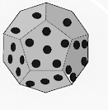
Using the class Dice
constructor
Dice cube(6); // construct six-sided dice
Dice dodeca(12); // construct twelve-sided dice
cout << "rolling " << cube.NumSides()
<< " sided die" << endl;
cout << cube.Roll() << endl;
cout << cube.Roll() << endl;
cout << "rolled " << cube.NumRolls()
<< " times" << endl;
member functions
See roll.cpp for full program

Slide 26
Dice Game Example
In this example, we will develop a game with two players. Both players will roll their own dice (first player1, and then player2, respectively in each iteration), and keep summing their score (rolling result) in an incremental way
This game will continue until one of the player reaches 20
Since player1 starts first each iteration, this player has an advantage to reach 20 earlier and win the game; to balance the situation between players, we will assume that
player1 has a dice with 6 sides (can roll a number between 1-6 in each iteration)
player2 has a dice with 7 sides (can roll a number between 1-7 in each iteration)
Let's have a look at next two slides for the sample runs

Slide 27
Dice Game Example
Sample Run 1:
Player 1 rolled 3 now, and reached 3 in total.
Player 2 rolled 4 now, and reached 4 in total.
Player 1 rolled 1 now, and reached 4 in total.
Player 2 rolled 6 now, and reached 10 in total.
Player 1 rolled 5 now, and reached 9 in total.
Player 2 rolled 1 now, and reached 11 in total.
Player 1 rolled 5 now, and reached 14 in total.
Player 2 rolled 2 now, and reached 13 in total.
Player 1 rolled 5 now, and reached 19 in total.
Player 2 rolled 5 now, and reached 18 in total.
Player 1 rolled 2 now, and reached 21 in total.
Player 1 won the game

Slide 28
Dice Game Example
Sample Run 2:
Player 1 rolled 4 now, and reached 4 in total.
Player 2 rolled 5 now, and reached 5 in total.
Player 1 rolled 2 now, and reached 6 in total.
Player 2 rolled 6 now, and reached 11 in total.
Player 1 rolled 5 now, and reached 11 in total.
Player 2 rolled 4 now, and reached 15 in total.
Player 1 rolled 3 now, and reached 14 in total.
Player 2 rolled 6 now, and reached 21 in total.
Player 2 won the game Check DiceGame.cpp for the solution.

Slide 29
From Interface to Implementation
The header file provides compiler and programmer information about how to use a class, but no information about how the class is implemented
Important separation of concepts
use without complete understanding of implementation
Implementation file is a cpp file with no main function
member function and constructor bodies are given
sometimes some other functions are also given

Slide 30
What you can and cannot do with Dice
Cannot define a Dice object without specifying number of sides
Not a bug, just a design decision
You may modify the class implementation to have a default constructor
Dice d(2); // ok, like a coin
Dice cube; // NOT ok, won’t compile
How random is a Dice object – how can we test this?
Calculate number of rolls needed to obtain a target sum
Repeat this several times and find the average in order to approach to the expected value
Repeat for all target values between 2 and 12 using two 6-sided dice
Any expectations? Needs probability knowledge.
See testdice.cpp

Slide 31
Classes: From Use to Implementation
We've used several classes
A class is a collection of objects sharing similar characteristics
A class is a type in C++, like int, bool, double
A class encapsulates state and behavior
string (this is a standard class), needs #include <string>
Objects: "hello", "there are no frogs", …
Methods: substr(…), length(), find(…), operators such as + and <<
Date needs #include "date.h"
Objects: December 7, 1949, November 22, 1963
Some Methods: MonthName(), DaysIn(), operator - etc.

Slide 32
State and Behavior
Behavior of a class is what a class does
described in verbs
babies eat, cry
robots move
In OOP terminology, behavior is defined by public member functions
for Dice class, member functions are the Dice constructor, NumRolls(), NumSides(), etc.
State of a class depends on physical properties
cars have four wheels, different colors
Dice have number of sides
In OO programming, state is defined by private data in header file
also called member data, instance variables, or data fields
for Dice class, mySides and myRollCount (see dice.h)

Slide 33
Objects
An object is an instance of a class
When created, in memory, a set of private data members are allocated and initialized according to the constructor function
In other words, each object has a different state
However, objects share member function implementations
The same function name is used on all objects of the same class
When a member function is called on an object, that object’s private data members are accessed and/or modified

Slide 34
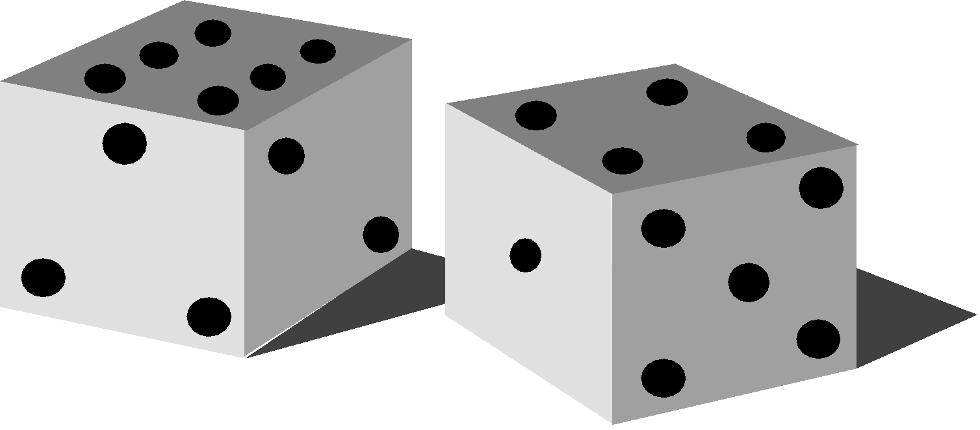
Anatomy of the Dice class
The class Dice
Objects: 6-sided dice, 32-sided dice, one-sided dice
Methods: Roll(), NumSides(), NumRolls()
A Dice object has state and behavior
Each object has its own state, like each int has its own value
Number of times rolled, number of sides
All objects in a class share method implementations (member function), but access their own state
How to respond to NumRolls()? Return my own # of rolls

Slide 35
The header file is a class declaration
Private data are called instance variables (private data members)
each object has its own private data
Public functions are called methods, member functions, these are called by the client programs
All objects of a particular class share the method implementations
The header file is an interface, not an implementation
Description of behavior, analogy to DVD player
Do you know how DVD player operates?
You do not mind, just press the button (interface) and watch!
Square root button on a calculator, how does it work? Do you care?
Header file provides information to compiler and to the programmers
Compiler determines what methods/member functions can be called for the objects of a class
Programmer reads header file to determine what methods are available, how to use them and other information about the class

Slide 36
What to know?
Client programmer (programmer who uses the classes) needs to know the interface from the header file
public member functions and constructors
parameters, how they behave
does not need to know private data (instance variables)
does not need to know how the member functions are implemented
just need to know where (in which file) it is implemented in order to include the implementation file in the project
As a good programmer who will design and/or update classes, YOU may need to know about the class implementations

Slide 37
From interface to use, the class Dice
Objects constructed
cube
#include "dice.h"
int main()
{
Dice cube(6);
Dice dodeca(12);
mySides
myRollCount
0
6
dodeca
myRollCount
mySides
0
12
cout << cube.Roll();
Method invoked
cube
myRollCount
mySides
1
6
int k;
for(k=0; k < 6; k++)
cout << dodeca.Roll();
return 0;
}
After for loop
dodeca
myRollCount
mySides
6
12

Slide 38
Implementation: the .cpp file
In the implementation file, we see all member functions written, similar idea as the functions we've seen so far
Each function has a name, parameter list, and return type
A member function’s name includes its class name
return_type class_name :: function_name (parameters)
A constructor is a special member function for initializing an object, constructors have no return type
class_name :: class_name (parameters)
:: is the scope resolution operator
specifies the class of the function
Each method can access private data members of an object (the object on which this member function will operate)
This way, at each invocation, member function can access different objects' private data
day1.DayName() compared to day2.DayName()
dot operator . is used when a member function is called

Slide 39
dice.cpp (Implementation file) – 1/2
Dice::Dice(int sides)
// postcondition: all private fields initialized
{
myRollCount = 0;
mySides = sides;
}
int Dice::NumSides() const
// postcondition: return # of sides of die
{
return mySides;
}
Constructor

Slide 40
dice.cpp (Implementation file) – 1/2
int Dice::NumRolls() const
// postcondition: return # of times die has been rolled
{
return myRollCount;
}
int Dice::Roll()
// postcondition: number of rolls updated
// random 'die' roll returned
{
RandGen gen; // random number generator
myRollCount= myRollCount + 1; // update # of rolls
return gen.RandInt(1,mySides); // in range [1..mySides]
}

Slide 41
Understanding Class Implementations
Private data members are global such that they are accessible by all class member functions
e.g. in the implementation of Month function, myMonth is not defined, but used
Constructors should assign values to each instance variable
this is what construction is
not a rule, but a general programming style

Slide 42
Understanding Class Implementations
Methods (member functions) can be broadly categorized as accessors or mutators
Accessor methods may access information about an object but do not change the state (private data members)
Date::Day() and Date::Month() are accessor methods since they do not change the private data members
Mutator methods change the state of an object
Post-increment/decrement operators, since they change an object's myDay and may also change myMonth and myYear

Slide 43
Class Implementation Heuristics
All data should be private
Provide accessor and mutator member functions as needed
Make accessor functions const
By putting const after all parameters
In both class definition (header file) and class implementation
A const function cannot modify the state of an object
Precaution against poor implementations
Compilers do not allow to update private data in const functions
int Date::Month() const
// postcondition: returns month of Date
{
return myMonth;
}

Slide 44
Struct vs Class
The only difference between a class and a struct in C++ is that structs have default public members and bases and classes have default private members and bases.
Both classes and structs
can have a mixture of public, protected and private members,
can use inheritance,
can have member functions.
If you only need to store data, we recommend you to use structs without any class-like features for simplicity.
If you need custom functions and private members having a class is easier to program.

Slide 45
Preprocessor
Compiler
Linker

Slide 46
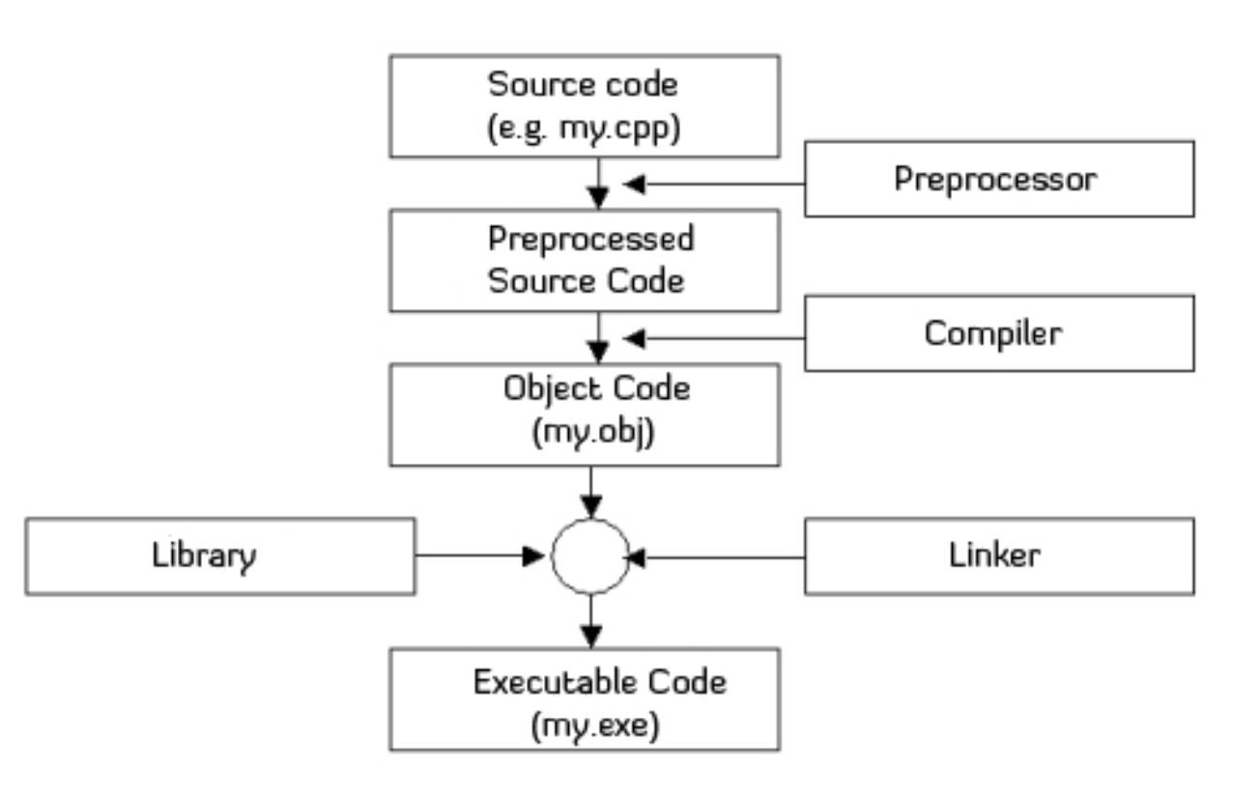
Three phases of creating an executable program
Preprocessing
Compilation
Linking

Slide 47
Preprocessing
The preprocessor processes all #include directives (and other preprocessor commands – all preprocessor commands start with #)
creates a translation unit which is the input of the next step (compilation)
all #include’d files are pasted in the translation unit recursively
e.g. replaces #include "foo.h" with contents of file foo.h, and does this recursively, for all #includes that foo.h includes and so on
exceptions
there are some preprocessor directives that causes conditional preprocessing
#ifndef _FOO_H // if _FOO_H is not defined
#define _FOO_H // define it and
… header file for Foo goes here // include header file
#endif
if _FOO_H is not defined, then it is defined and file is included, otherwise file is not included
prevents multiple inclusion of the same header file in a program

Slide 48
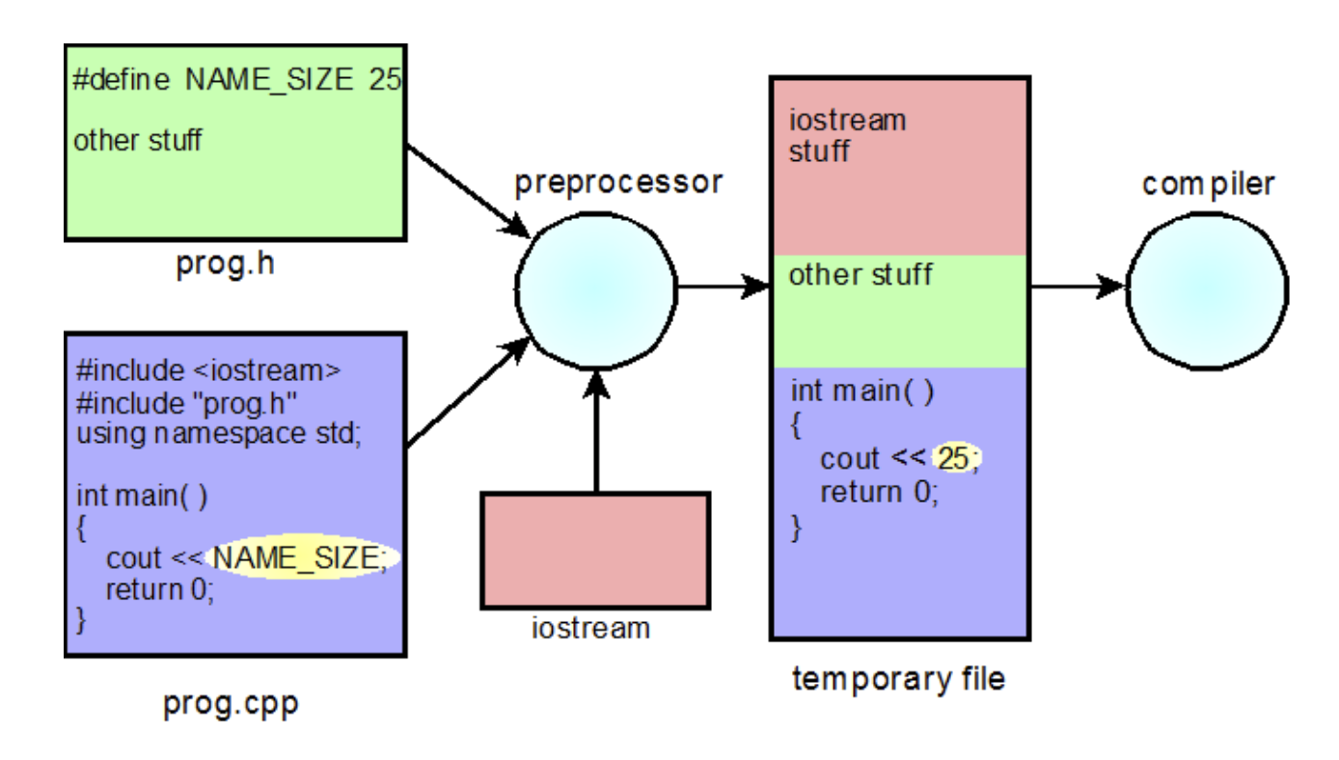
Preprocessing

Slide 49
Preprocessing
Where are the include files located?
You can ask the preprocessor to look in certain directories in order (Tools->Options->Directories...).
e.g. You can add your directory after the system directories to be automatically searched for referenced include files
You get an error if the include file is not found in these directories
adding an include file to the project is not sufficient

Slide 50
Preprocessing
#define identifier token
Another compiler directive
Generally written at the beginning of program (not in a function)
All instances of identifier in all functions are replaced with token during preprocessing
Token is any character sequence
Example
#define LENGTH 10
...
cout << LENGTH << endl;
Displays 10 on screen
The above statement is compiled as
cout << 10 << endl;
Because LENGTH is replaced with 10 before compilation (during preprocessing)

Slide 51
Compiler
The compiler takes a translation unit as input and produces compiled object code as output
The object code is platform/architecture specific
The source code is the same on all platforms
We may need to compile several cpp files
dice.cpp, randgen.cpp, date.cpp, …
because some functions and class implementations are in those files
if you are using them in your program, you have to compile them together with your main cpp file
add to the same project
you may generate libraries out of those files
ready-to-use object code
need not to compile, but add the .lib file to the project

Slide 52
Linker
Linking combines object files and libraries to create a single executable program (the file with .exe extension)
May still create errors even if compilation is successful
unresolved external symbol ...
undefined symbol ...
Primary reason would be missing libraries or implementation files (like date.cpp, dice.cpp)
header files provide the definition, but body is missing!
If you have such errors, try to find where those symbols are implemented and include those libs or cpps in your project

Slide 53
Compiling, Linking
Single file case
Linking is necessary to use the libraries
Examples: iostream for cin and cout, string for string class operations
Library functions are defined (prototypes) in header files (#included)
Library function bodies are ready in object code
linked
myprog.cpp
(source code)
myprog.obj
(object code)
myprog.exe
compile
link

Slide 54
Compiling, Linking
Several .cpp files
user-defined class implementations and some utility functions can be written in different .cpp files
those files are independently compiled and then linked together to create the executable code
libraries are linked too
roll.cpp: client program
int main (){
Dice cube(6);
Dice dodeca(12);
...
cout << cube.Roll() << endl;
...
return 0;
}
roll.o: object code
1010110111101110101101010101 ...
COMPILE
LINK
dice.cpp: class implementation
Dice::Dice(int sides){
myRollCount = 0;
mySides = sides;
}
...
dice.o: object code
1101010101101010100110010101010 ...

Slide 55
#include
Kind of copy-paste
specified header file is copied before compilation
Include file locations
standard ones are in INCLUDE directory under
…\Microsoft Visual Studio 11.0\VC\include
Tools → Options → Projects and Solutions → VC++ Directories
can specify more directories to search for header files
Difference between
#include <filename>
only search in directories specified in options
mostly used for standard header files like iostream
#include "filename"
first search in the local directory, then the ones in options
for user defined header files

Slide 56
Adding Files to Projects in VC++
.cpp files that are compiled and linked together (like class implementations) must be added to the project
otherwise link error
Standard libraries are found and linked automatically
no need to add anything for them
User-defined libraries, if available in object code (e.g. .lib files), must be added to the project
otherwise link error
Header files may or may not be added in project
If not added, they are shown as "external dependencies" and this is OK
No matter added to the project or not, the compiler still needs to find the header files in a folder
They may not be found if directory settings are wrong, so be careful!

Slide 57
Updating an existing class

Slide 58
Updating a Class (not in book)
Suppose you want to add more functionality to the date class
Need to change the header file (date.h)
Need to add implementation of new function(s) to date.cpp
Example: a new member function to calculate and return the remaining number of days in the object’s month
Any ideas? Do you think it is too difficult?
Have a look at the existing member functions and see if they are useful for you

Slide 59
Updating a Class (not in book)
We can make use of DaysIn member function
Prototype in Date class (add to the header file)
int RemainingDays () const;
Implementation
int Date::RemainingDays () const
{
return DaysIn() - myDay;
}
In a member function implementation private data and other member functions referred without the dot operator
They operate on the object for which the member function is called

Slide 60
Updating a Class (not in book)
Example use of RemainingDays Date today; cout << "There are " << today.RemainingDays() << " days left in the current month" << endl;
See date_modified.h, date_modified.cpp and demodate2.cpp
When RemainingDays is called
Call to DaysIn is for object today
since it is the object on which RemainingDays is called
myDay is today's myDay
since it is the object on which RemainingDays is called

Slide 61
Updating a Class (not in book)
This time, let's add more functionality to the RandGen class
Need to change the header file (RandGen.h)
Need to add implementation to RandGen.cpp
Example: a new member function (say RandChar) that takes a string parameter (say s), and returns a random character of this string parameter s.
char RandChar (const string& s);
// char RandChar (const string&);
char RandGen::RandChar (const string& s){
return s.at(RandInt(s.length()));
// return s.at(RandInt(0, s.length())-1);
}

Slide 62
Updating a Class (not in book)
This time, let's add more functionality to the Dice class
Need to change the header file (Dice.h)
Need to add implementation to Dice.cpp
Example: a new member function (say MultipleRoll) that takes an integer parameter (say n), rolls the dice object n times, and returns the sum of the outcomes of these n rolls.
int MultipleRoll(int n);
// int MultipleRoll(int);
int MultipleRoll(int n){
sum = 0;
for (unsigned int i=0; i<n; i++)
sum += Roll();
return sum;
}

Slide 63
Designing a new class

Slide 64
Design Heuristics
What is a heuristic?
a set of guidelines and policies
may not be perfect, but mostly useful
exceptions are possible
e.g. making all state data private is an heuristic
we will see two more class design heuristics
cohesion and coupling
Make each function or class you write as single-purpose as possible
Avoid functions that do more than one thing, such as reading numbers and calculating avr, std, maximal number, etc.
If source of numbers changes how do we do statistics?
If we want only the average, what do we do?
Classes should embody one concept, not several
This heuristic is called Cohesion
Functions (both member and free functions) and classes should be cohesive, doing one thing rather than several things
Easier to re-use in multiple contexts and several applications

Slide 65
Design Heuristics continued (Coupling)
Coupling: interactions among functions and classes
Functions and classes must interact to be useful
One function calls another
One class uses another, e.g., as the Dice::Roll() function uses the class RandGen
Keep interactions minimal so that classes and functions don't rely too heavily on each other: it is better if we can change one class or function (to make it more efficient, for example) without changing all the code that uses it
Some coupling is necessary for functions/classes to communicate, but keep coupling loose and be aware of them

Slide 66
Implementing Classes – Iterative Enhancement
It is difficult to determine what classes are needed, how they should be implemented, which functions are required
Experience is a good teacher, failure is also a good teacher
Good design comes from experience, experience comes from bad design
Design and implementation combine into a cyclical process: design, implement, re-visit design, re-implement, test, redesign, …
Grow a working program, don’t do everything at the same time

Slide 67
Design and Implementation Heuristics
A design methodology says that
"look for nouns, those are classes", and then "look for verbs and scenarios, those are member functions"
Not every noun is a class, not every verb is a member function
some functions will be free ones or will be implemented in main (these are design decisions)
Concentrate on behavior (member functions) first when designing classes, then on state (private part)
private data will show its necessity during the implementation of the public part

Slide 68
Example class design
Quiz class
simple quiz of addition questions
Scenarios
user is asked a number of questions
computer asks random questions
user enters his/her answer
correct / not correct
feedback and correct answer are displayed
correct answers are counted
There may be two classes
question
quiz
but we will have one class which is for question and implement quiz in main

Slide 69
Question class
Question behaviors (verbs). A question is
created
asked
answered
checked
These are candidate member functions
more? less? we will see
A question is simply two random integers (to keep it simple say between 1 and 100) to be added
those numbers are definitely in class private data
what else?
we will see

Slide 70
Constructor
Constructors are special member functions of a class
When an object of a class is created, C++ calls the constructor for that class
Properties:
Constructors have the same name as the class
Constructors do not return any values
Constructors are invoked first when an object is initialized
Any initializations for the class members, memory allocations are done in the constructor
Constructors may or may not take parameters
A constructor with no parameter is called default constructor

Slide 71
Constructor - more details
A constructor with parameters can also be default if default values of these parameters are provided at declaration
// default constructor
Point::Point()
{
x = 0;
y = 0;
}
// point.h
#ifndef POINT_H
#define POINT_H
class Point{
public:
// default constructor
Point();
// constructor with parameters
Point(int xx, int yy);
. . .
private:
int x;
int y;
};
#endif
// constructor with parameters
Point::Point(int xx, int yy)
{
x = xx;
y = yy;
}
// combine the two
Point::Point(int xx=0, int yy=0)
{
x = xx;
y = yy;
}

Slide 72
Constructor - more details
using initializer list
Syntax
ConstructorHeader : privatedata1 (value1), privatedata2(value2), … privatedataN (valueN){
// other constructor code comes here,
// executed after assigning values in initializer list
}
Examples
// Default constructor
Point::Point() : x(0), y(0) {}
// Alternative default constructor implementation
Point::Point() : x(0){
y = 0;
}
// Constructor with parameters
Point::Point(int xx, int yy) : x(xx), y(yy){}

Slide 73
Question class
simplemathquest.h (first draft)
class Question{
public:
Question(); // create a random question
void Ask() const; // ask the question to user
int GetAnswer() const; //input and return user answer
bool IsCorrect (int answer) const; //check if correct
private:
int myNum1; // numbers used in question
int myNum2;
};

Slide 74
Quiz program (main - simplequiz.cpp) – Draft 1
int qNum = PromptRange("how many questions: ",1,5);
int k, ans, score =0;
for(k=0; k < qNum; k++){
Question q;
q.Ask();
ans = q.GetAnswer();
if (q.IsCorrect(ans)){
cout << ans << " correct answer" << endl << endl;
score++;
}
else
cout << "Sorry, not correct. Correct answer was " << ???????? << endl << endl;
}
cout << "Score is " << score << " out of " << qNum
<< " = " << double(score)/qNum * 100 << "%" << endl;
Something missing: a function to return the correct result

Slide 75
Question class
simplemathquest.h (second draft)
class Question{
public:
Question(); // create a random question
void Ask() const; // ask the question to user
int GetAnswer() const; //input and return user answer
bool IsCorrect (int answer) const; //check if correct
int CorrectAnswer() const; // return correct answer
private:
int myNum1; // numbers used in question
int myNum2;
};

Slide 76
Quiz program (main - simplequiz.cpp) – Draft 2
int qNum = PromptRange("how many questions: ",1,5);
int k, ans, score =0;
for(k=0; k < qNum; k++){
Question q;
q.Ask();
ans = q.GetAnswer();
if (q.IsCorrect(ans)){
cout << ans << " correct answer" << endl << endl;
score++;
}
else
cout << "Sorry, not correct. Correct answer was " << q.CorrectAnswer() << endl << endl;
}
cout << "Score is " << score << " out of " << qNum
<< " = " << double(score)/qNum * 100 << "%" << endl;
Notes:
Prompt class ilk defa görecekler !!!!

Slide 77
Question class implementation
simplemathquest.cpp (first draft)
Question::Question(){
RandGen gen;
myNum1 = gen.RandInt(1,100); myNum2 = gen.RandInt(1,100);
}
void Question::Ask() const{
cout << myNum1 << " + " << myNum2 << " = ";
}
int Question::GetAnswer() const{
int ans;
cin >> ans;
return ans;
}
Constructor
Oooops! We did not access or modify the object's state. It is better not to have this function as a member function.

Slide 78
Question class implementation
simplemathquest.cpp (first draft) -- continued
bool Question::IsCorrect(int answer) const{
return ????? == answer;
}
int Question::CorrectAnswer() const{
return ?????;
}
Problem: Where is the correct answer stored?
A new private data field would be good

Slide 79
Question class
simplemathquest.h (final)
class Question{
public:
Question(); // create a random question
void Ask() const; // ask the question to user
int GetAnswer() const; //input and return user answer
bool IsCorrect (int answer) const; //check if correct
int CorrectAnswer() const; // return correct answer
private:
int myNum1; // numbers used in question
int myNum2;
int myAnswer; // store the answer
};

Slide 80
Question class implementation
simplemathquest.cpp (final)
Question::Question(){
RandGen gen;
myNum1 = gen.RandInt(1,100); myNum2 = gen.RandInt(1,100);
myAnswer = myNum1 + myNum2;
}
void Question::Ask() const{
cout << myNum1 << " + " << myNum2 << " = ";
}
int Question::GetAnswer() const{
int ans; cin >> ans;
return ans;
}

Slide 81
Question class implementation
simplemathquest.cpp (final) -- continued
bool Question::IsCorrect(int answer) const{
return myAnswer == answer;
}
int Question::CorrectAnswer() const{
return myAnswer;
}

Slide 82
Quiz program (main - simplequiz.cpp) – Final
int qNum = PromptRange("how many questions: ",1,5);
int k, ans, score =0;
for(k=0; k < qNum; k++){
Question q;
q.Ask();
cin >> ans;
if (q.IsCorrect(ans)){
cout << ans << " correct answer" << endl << endl;
score++;
}
else
cout << "Sorry, not correct. Correct answer was " << q.CorrectAnswer() << endl << endl;
}
cout << "Score is " << score << " out of " << qNum
<< " = " << double(score)/qNum * 100 << "%" << endl;

Slide 83
Think Further
What about a generic question class
not only addition, but also other arithmetic operations
may need another private data member for the operation that is also useful to display the sign of the operation in Ask
may need parameter in the constructor (for question type)
will do this week in recitations
What about questions for which answers are strings?
maybe our generic question class should have string type answers to serve not only to arithmetic questions but any type of questions

